Slide 1
Capstone Project: Analytical CRM Development for a Bank

Slide 2
Overview
What is Customer churn? This is essentially the rate at which customers leave a business against the total customers that are actively in business. This is also known as churn rate or customer attrition.
Project Objective:
The objective of this analysis is to discover various factors contributing to increased customer churn rate at the bank, and provide the business users with these insights which they can use to make informed decisions and strategize on how to improve customer retention and reduce churn rate.
Tools: I used Excel ,MySQL , Power BI and Power Query for this analysis.

Slide 3
Data Dictionary
RowNumber: The row number in the dataset, likely used for reference or indexing.
CustomerId: A unique identifier for each customer.
CreditScore: A numerical representation of the customer's creditworthiness.
Credit score:
Excellent: 800–850
Very Good: 740–799
Good: 670–739
Fair: 580–669
Poor: 300–579
GeographyID: A numerical identifier that likely corresponds to a geographical location, such as a country or region.
GenderID: A numerical identifier for the customer's gender, where for example, '1' could represent male and '2' could represent female.

Slide 4
Age: The age of the customer.
Tenure: The number of years the customer has been with the bank.
Balance: Current balance in the customer's account.
NumOfProducts: refers to the number of products that a customer has purchased through the bank.
HasCrCard: denotes whether or not a customer has a credit card. This column is also relevant, since people with a credit card are less likely to leave the bank.
1 represents credit card holder
0 represents non credit card holder

Slide 5
IsActiveMember: active customers are less likely to leave the bank (as per the criteria defined by the bank for identifying the activeness).
1 represents Active Member
0 represents Inactive Member
Estimated Salary: as with balance, people with lower salaries are more likely to leave the bank compared to those with higher salaries.
Exited: whether or not the customer left the bank.
0 represents Retain
1 represents Exit
Bank DOJ: date when the Customer associated/joined with the bank.

Slide 6
Data Discovery
I opened the data in excel and inspected the columns for relevance to the business task (This can equally be done directly on Power Query), I was able to confirm that there is sufficient data to aid my analysis. However, data needed to be cleaned and properly transformed in the format that would be useful for the analysis.

Slide 7
Analytical Steps
Data Preparation
Data Categorization and Grouping
Formatting
Data Transformation
Data Modeling
Visualization — Report
Insights
Recommendation
Conclusion
Where Step 2- 4 are iterative as I had to repeat them as needed throughout this activity.

Slide 8
Data Preparation
1) I imported the data into MySQL and retrieved some information's from data that was I needed by writing queries.
2) After using MySQL ,I imported data into Power BI transformed it on Power Query as follows:
* I Checked the datatypes, headers ,duplicates , errors in my dataset and removed accordingly.

Slide 9
Data categorization and Grouping.
For the age, credit score, balance columns, I looked at the column profile from the View tab, and saw that there was a wide range between the minimum and maximum values.
The Age column had 60 distinct value with a minimum of 18 and a maximum of 82
The credit score column had 354 distinct values with a minimum of 376 and a maximum of 850.
The balance column had 650 distinct values. With a minimum of 0 and a maximum of 213146.2

Slide 10
Data categorization and Grouping.
The Tenure column had 5 distinct values. With a minimum of 3 and a maximum of 7
I then grouped each of them using conditional column function.

Slide 11
Formatting
The following column; Geography ID in Bank Churn table had Numeric datatype of 1 ,2and 3. However, this lacks clarity and would be confusing on the report. I formatted them by using the replace values option to change them to more intuitive data type and also changed the column name as Geography Location.
1 for France ,2 for Spain and 3 for Germany

Slide 12
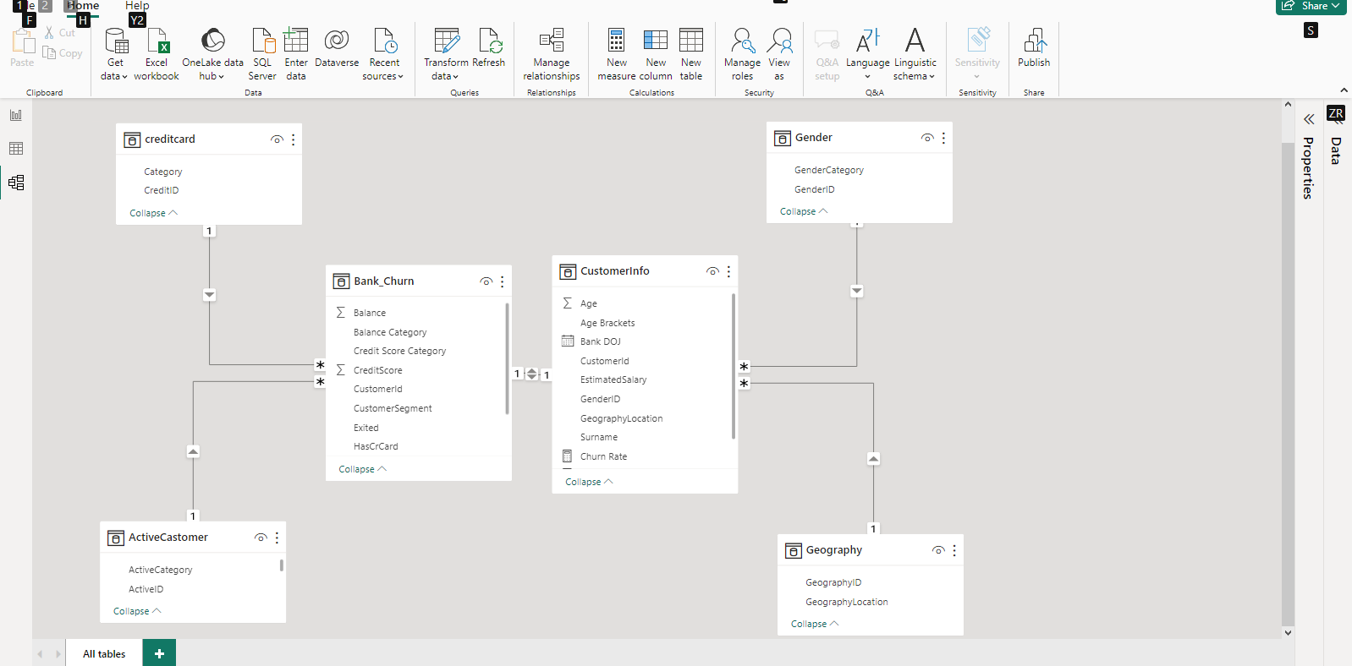
Data Modelling
Here, I explored the relationship between these tables and how they are connected. This is to make visualization easy.

Slide 13
Visualization — Report
I started the report by creating a few DAX measures.
DAX simply means Data Analysis Expression. It is an expression that helps with calculations while building report. The three I created were:
Customers(Number of customers)
Churn rate (%)
Customers Churned
Active Accounts

Slide 14
Step:
On the right pane where the tables are listed, I right clicked on the Customer Info Data table, then selected new measure. I labeled the measure as Number of Customers and used the formular below.

Slide 15
This formula above counted all the unique ID in the Customer ID column.
I repeated the above steps for the Customers Churned and Churn Rate measure with the respective formulars below:

Slide 16
Customers: 10K
Customers churned: 2037
Churn Rate: 20.4% ( Changed to % from the measures tool tab)
Finally, I built the report in the screenshot , taking into account the key factors like account balance, age group, activity status, gender, credit score, etc.. and their effects on the churn rate. This helped me gain insights into where the bank could make necessary improvements.

Slide 17
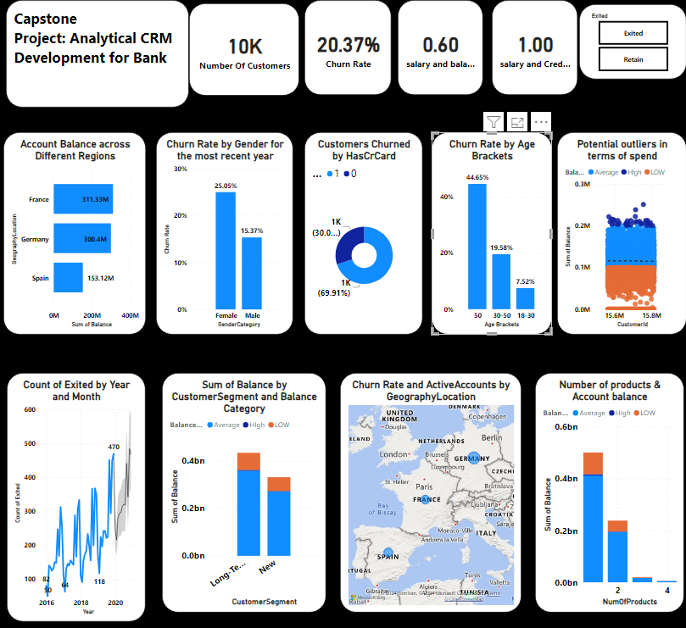

Slide 18
Insights
In terms of those with credit card facility, the churn rate is highest amongst fair credit score group 580-669.
Churn rate for Female customers is 25.05% and for male is 15.37%. So female customers are
more likely to churn.
customers whose account balance is between 1,00000 to 2,00000 are the most churned in
terms of account balance.
Overall, Churn rate is very high at 44.65% for customers above 50 years of age.
churn rate is high for product 1.

Slide 19
Recommendation
The stakeholders could consider creating products that target seniors close to their early retirement age to avoid losing them.
An incentive program could be considered for customers who have maintained longer relationship with the bank.
In the same way, an exclusive package such as travel and vacation packages, subsidized investment portfolio, etc., could be considered for the customers whose account balance is between 1,00000 to 200000, to reduce the rate at which they leave the bank.
The business needs to understand why there is high churn rate for Prod 1 customers and how to get them back in business.
In Summary, age group of above 50, people and those with account balance (1 lakh to 2 lakh) are most likely to churn. The bank should consider the recommendations above and other effective strategies that can address the findings, to better customer retention and reduce churn rate.

